Slide 1
INTRODUCTIOn
A supply chain is a network of all the entities, processes and activities involved in producing and delivering a product or service to the end customer. It encompasses everything from sourcing raw materials, manufacturing, transportation, warehousing, and distribution, to the final delivery of the product or service.
Here are the key components of a supply chain:
Suppliers: These are the entities that provide raw materials, components, or services needed to create a product. They are the starting point of the supply chain.
Retailers/Distributors: Retailers or distributors purchase products from manufacturers and sell them to end customers. They can be physical stores, online platforms, or wholesalers.
Customers: The final recipients of the products. Their demand drives the entire supply chain.
Supply Chain Management (SCM): This is the process of planning, implementing, and controlling the operations of the supply chain to maximize efficiency and reduce costs while meeting customer demands.

Slide 2
PROBLEM STATEMENT:
To explore the potential of blockchain technology in addressing the challenges of traditional supply chain by providing a decentralized, immutable and transparent ledger that can enhance the efficiency, security and traceability of supply chains. The solution should aim to:
Improve transparency and trust by enabling real-time visibility and traceability of goods from origin to destination.
Reduce the risk of fraud and counterfeiting by providing a tamper-proof record of all transactions and product movements.
Increase efficiency by automating processes and enabling seamless data sharing among all stakeholders.
Ensure data integrity and security, minimizing the risk of data breaches and unauthorized access.

Slide 3
WHY USE BLOCKCHAIN IN SUPPLY CHAIN:
1.Transparency and Accountability
Immutable Records: Once an order's status is updated or a new order is created, the changes are recorded on the blockchain. This ensures that the order history is transparent and cannot be altered, providing a clear audit trail of all transactions and status updates.
Event Logging: Events emitted by the contract (e.g. OrderCreated, OrderDelivering) are recorded on the blockchain. This helps all stakeholders track the status of orders in real-time and verify changes.
2. Automation of Processes
Status Transitions: The contract automates status transitions (e.g., from Created to Delivering) based on specific function calls. This reduces manual intervention and minimizes errors in updating the order status.
Role-Based Access Control: Modifiers like onlyOrderDeliveryCompany and onlyCustomer ensure that only authorized parties can perform certain actions, streamlining the process and enforcing proper protocol without manual oversight.

Slide 4
3. Efficient and Secure Operations
Decentralized Management: The contract operates on a decentralized network, reducing reliance on a central authority or intermediary. This can lower costs and increase efficiency by automating order management and verification processes.
Reduced Fraud: Since the contract enforces rules and records all actions on the blockchain, it helps prevent fraudulent activities, such as unauthorized changes to order status or creation of fake orders.
4. Improved Communication and Coordination
Real-Time Updates: Stakeholders (suppliers, delivery companies, and customers) can see real-time updates about order statuses. This improves coordination and reduces misunderstandings or disputes about the current status of an order.
Clear Documentation: The contract provides a clear and easily accessible record of all orders and their statuses, which can be useful for audits, compliance, and resolving any issues that arise.
5. Enhanced Trust
Trustless Environment: The blockchain's inherent characteristics create a trustless environment where parties do not need to trust each other directly. They can trust the contract to enforce rules and manage orders fairly and transparently.

Slide 5
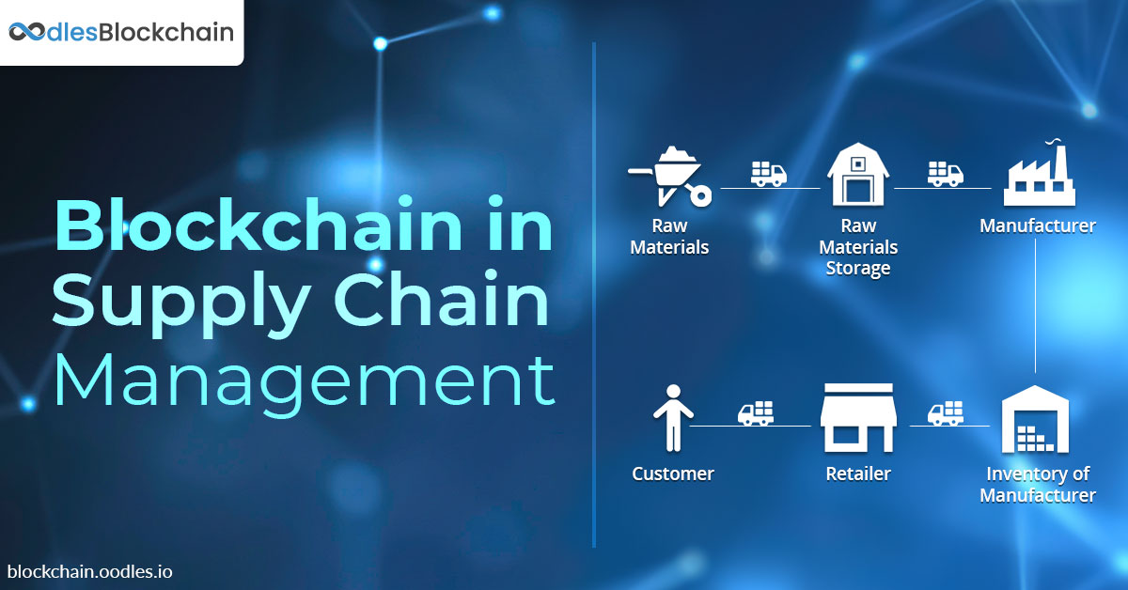
OVERVIEW OF OUR PROJECT

Slide 6
SOME COMPONENTS OF OUR PROJECT:
Functions:
The smart contract contains different functions which carries out different tasks. Some of the functions are listed below:
getOrder Function: This function retrieves the details of a specific order based on its index
createOrder Function: This function creates a new order and adds it to the orders array.
startDeliveringOrder Function: This function changes the status of an order to Delivering, indicating that the delivery process has started.
stopDeliveringOrder Function: This function changes the status of an order to Delivered, indicating that the delivery process has been completed.
acceptOrder Function: This function allows the customer to accept the order after it has been delivered, changing the status to Accepted.
declineOrder Function: This function allows the customer to decline the order after it has been delivered, changing the status to Declined.

Slide 7
Modifiers:
Modifiers in the Supply Chain contract are used to enforce specific conditions before certain functions can be executed. Each modifier checks a particular condition related to the state of an order or the role of the user interacting with the contract. Some of the modifiers which are used in the code listed below:
onlyOrderDeliveryCompany: Ensures that only the delivery company associated with a specific order can execute the function it modifies.
onlyCustomer Modifier: Ensures that only the customer associated with a specific order can execute the function it modifies.
orderCreated Modifier: Ensures that the order is in the Created status before the function it modifies can be executed.
orderDelivering Modifier: Ensures that the order is in the Delivering status before the function it modifies can be executed.
orderDelivered Modifier: Ensures that the order is in the Delivered status before the function it modifies can be executed.

Slide 8
Thank you!
Team members:
Anand Bajaj
Ojaswi Prakash

